Slide 1

FLIGHT MANAGEMENT SYSTEM
Presented By
Pamujula Latha Bhavyasri - 52130345 ( LOGIN PAGE )
Singam Kalyan Kumar Reddy - 52130343 ( UPDATE FLIGHT INFORMATION )
Vutukuri Akhila - 52130335 ( RESERVATION )
Janagari Keerthi Reddy - 52130340 ( CANCELLATION )
Raashi Singh - 52124616 ( RESERVATION STATUS )
R Lakshmi Sai Chetana Nath - 52124536 ( PAYMENTV MODULE )
Lakshmi Narayanan A S - 52130324 ( REPORT ) BATCH -03

Slide 2
CONTENTS
INTRODUCTION
LOGIN
REGISTRATION
SET NEW PASSWORD
UPDATE FLIGHT INFORMATION
RESERVATION
PAYMENTS
CANCELLATION
VIEW RESERVATION STATUS
REPORT

Slide 3
INTRODUCTION
Online bookings play a main role in our day to day life as we, busy people need all the process to be done so fast.
As an example , we developed a java project for flight management system where the user can book tickets for the required flights and do the operations according to their needs.
We used : FRONT END :
ECLIPSE for java programming
JDK SERVER for ECLIPSE
WINDOW BUILDER software for GUI application
BACKEND :
SQL for database
Jconnector for backend connection

Slide 4
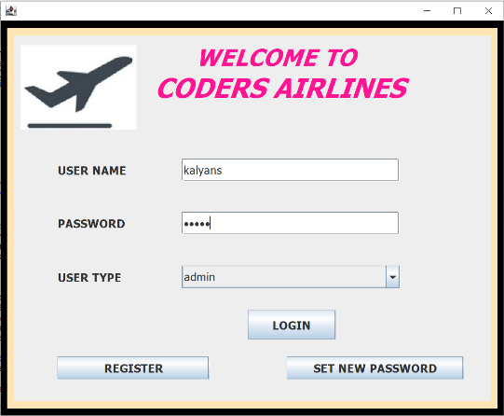
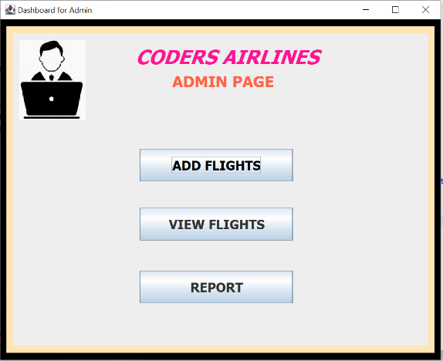
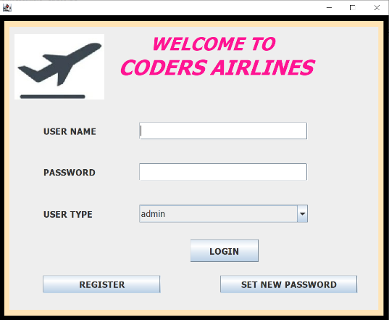
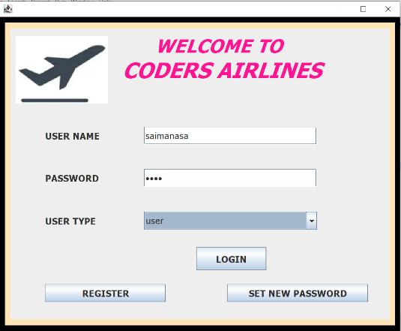
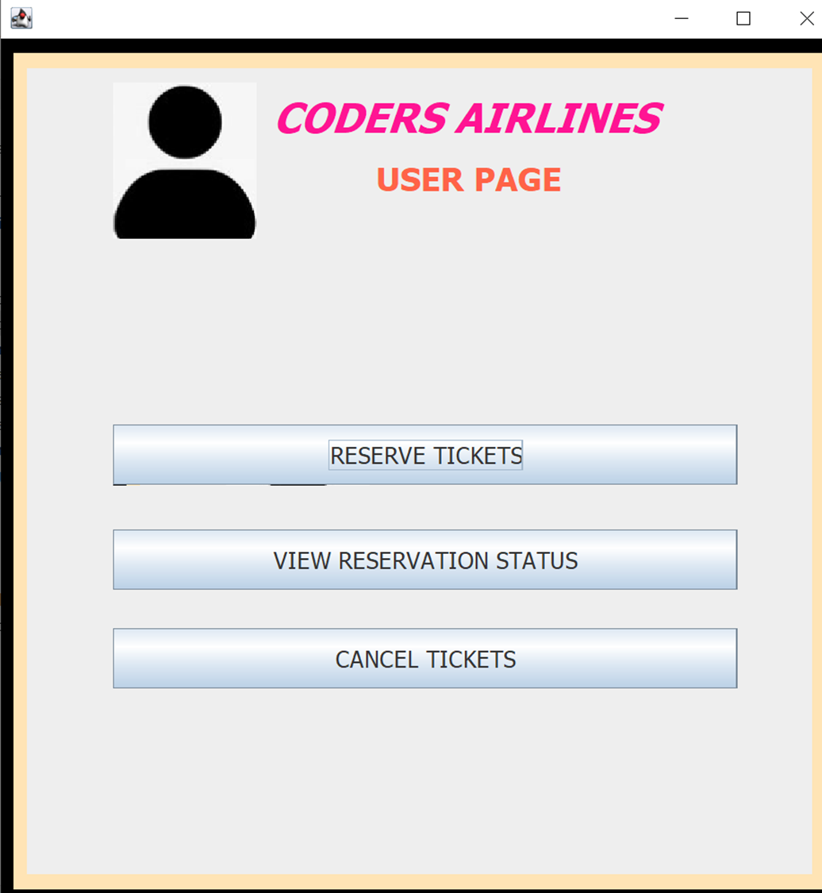
LOGIN
If user or admin wants to login in to the portal they can use the login page.
If user logged in , user will get a user page.
If admin logged in ,admin will get the admin page.
User or admin can do their wanted operations in their specified pages.

Slide 5
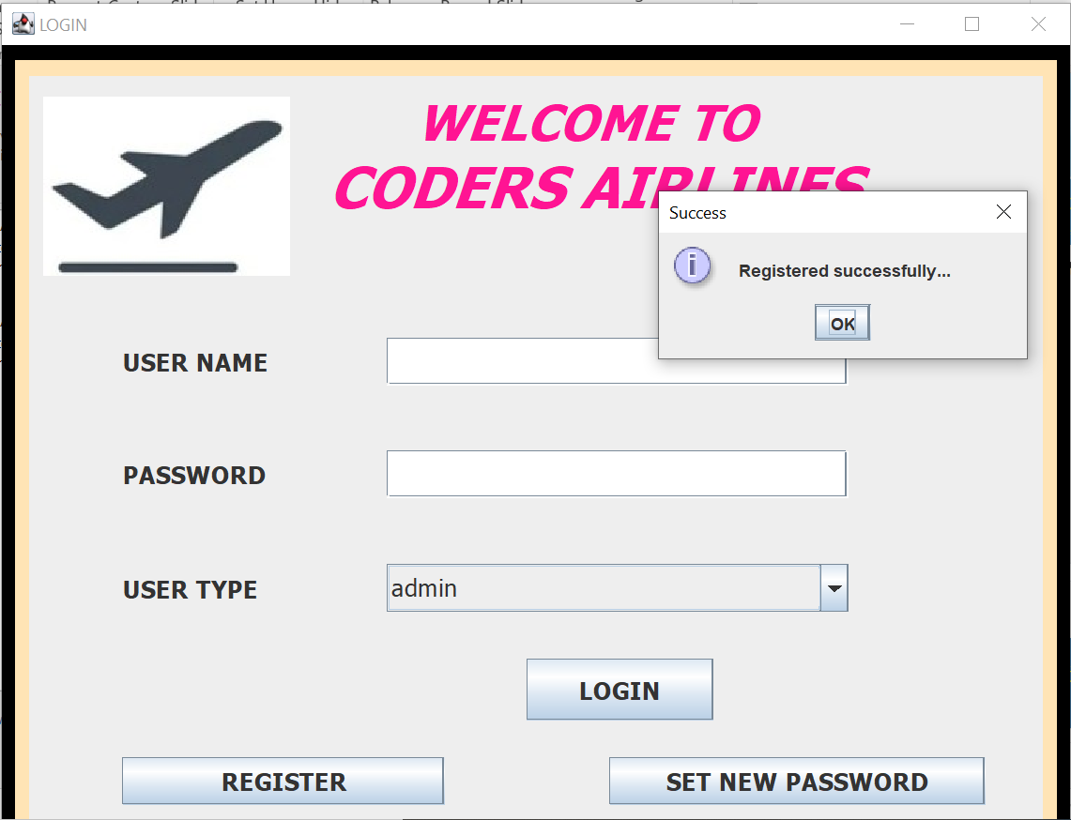
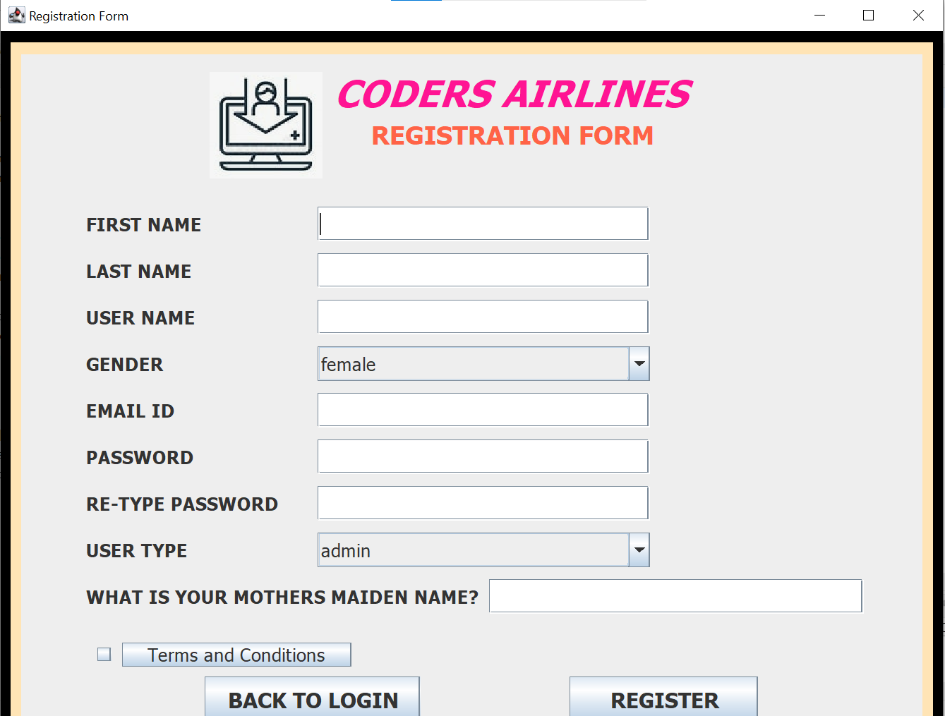

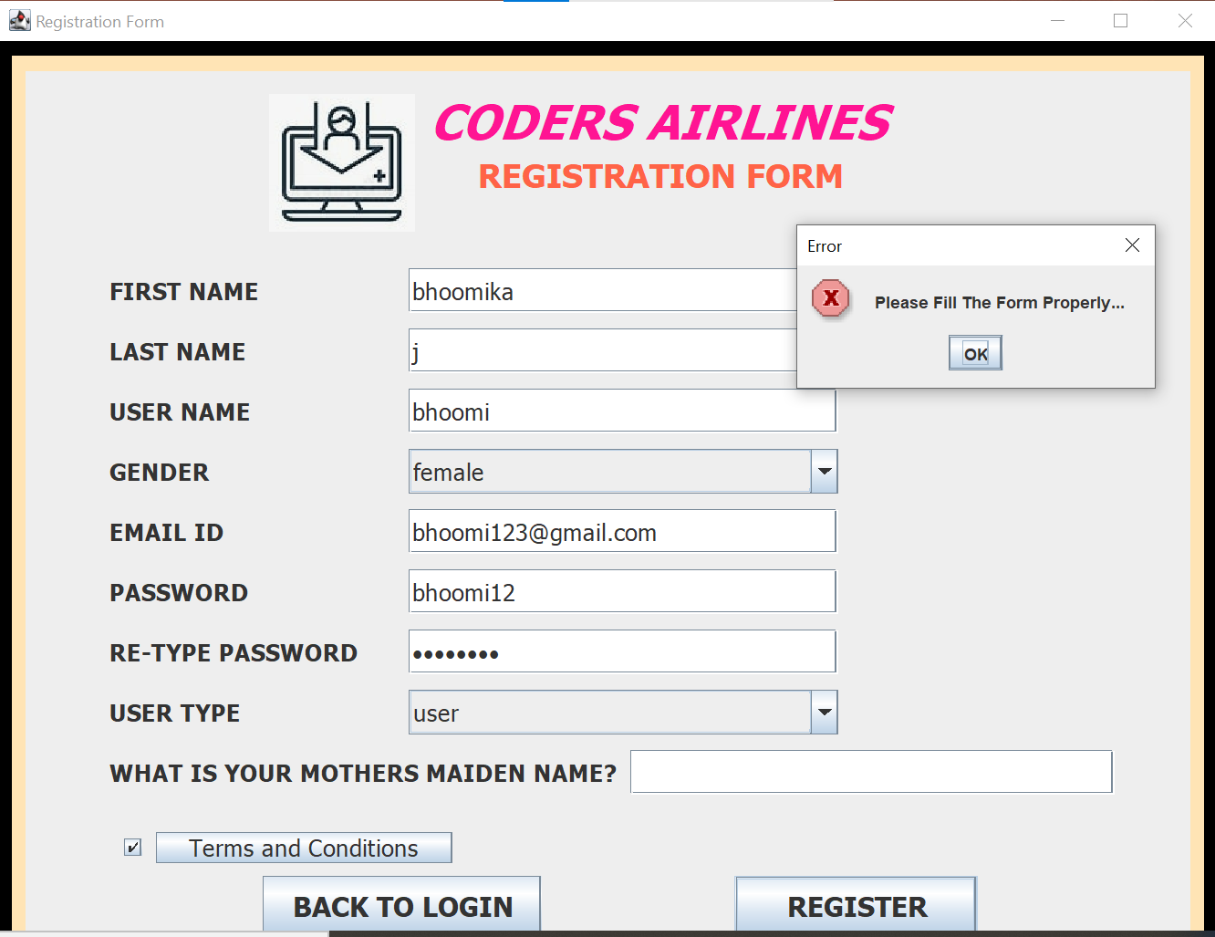

REGISTRATION
If a new user or admin wants to register then they should follow the
patterns and needs to accept the terms and conditions and need to fill the form properly.
If not filled, an error message will pop up.
If it is filled properly then the details will be successfully added into the database

Slide 6
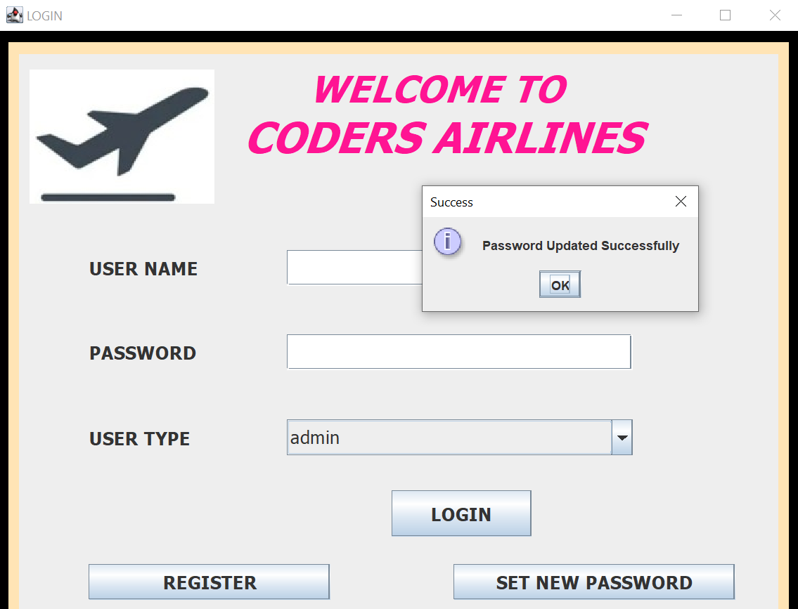
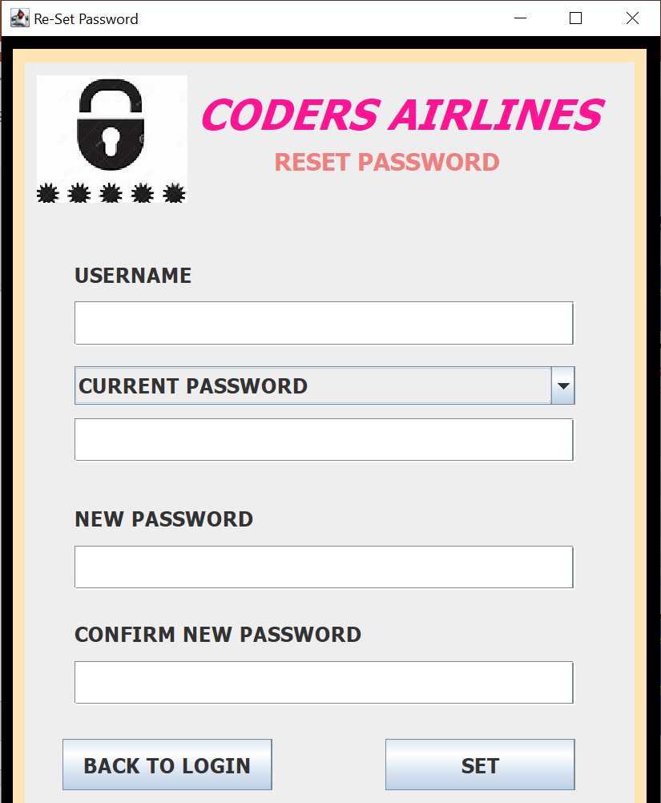

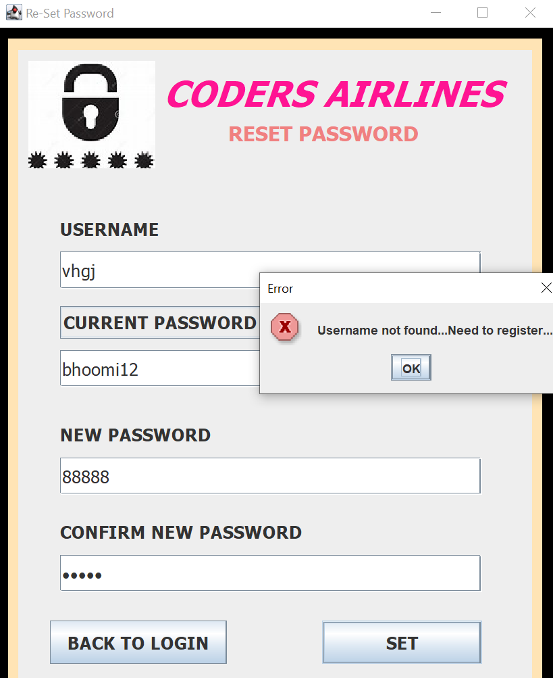
RE-SET PASSWORD
If user or admin wants to set a new password ,they can use this module.
There will be an error message if the username does not exist in the database, they need to register.
If username exsists then the password will be updated successfully.

Slide 7
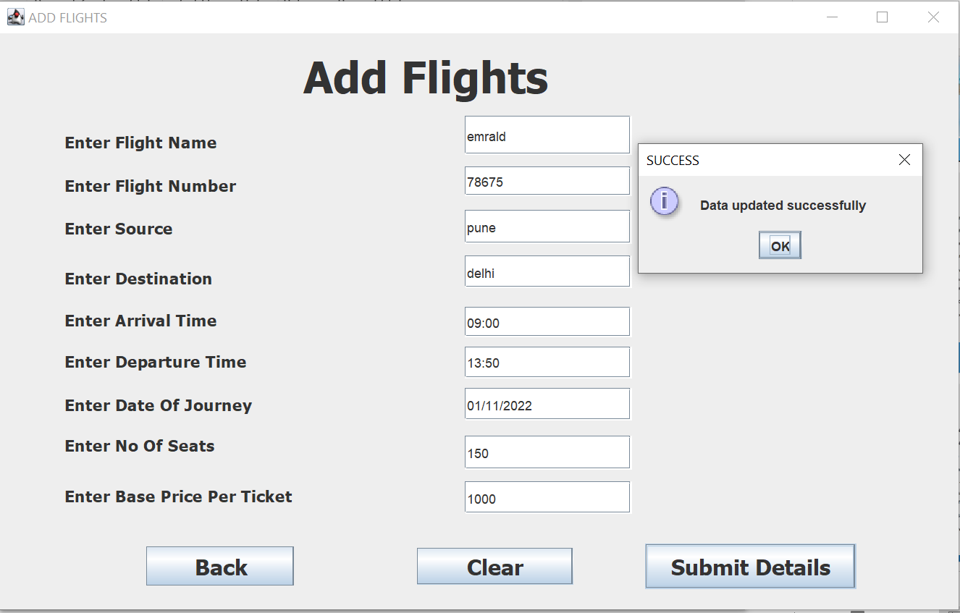

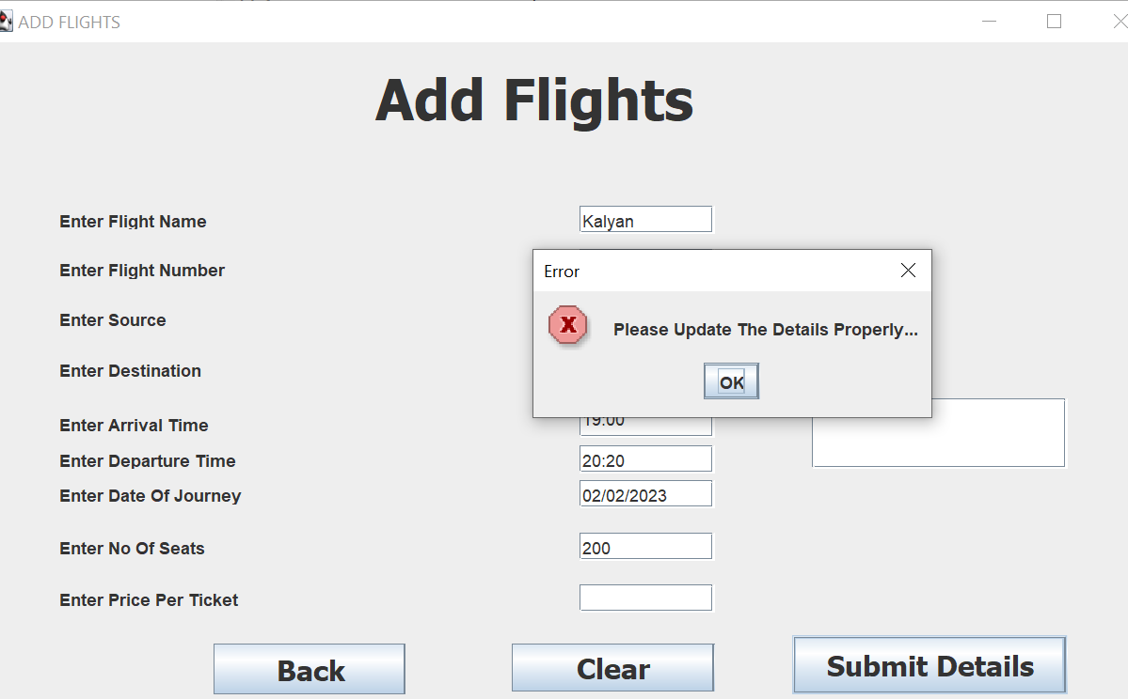
UPDATE FLIGHT INFORMATION
ADD FLIGHTS
This module will be enabled for admin only for updating the flight information purpose.
It will show error message or success message according to the inputs.
After adding the flight details the user can be updated with the new flight schedule.

Slide 8
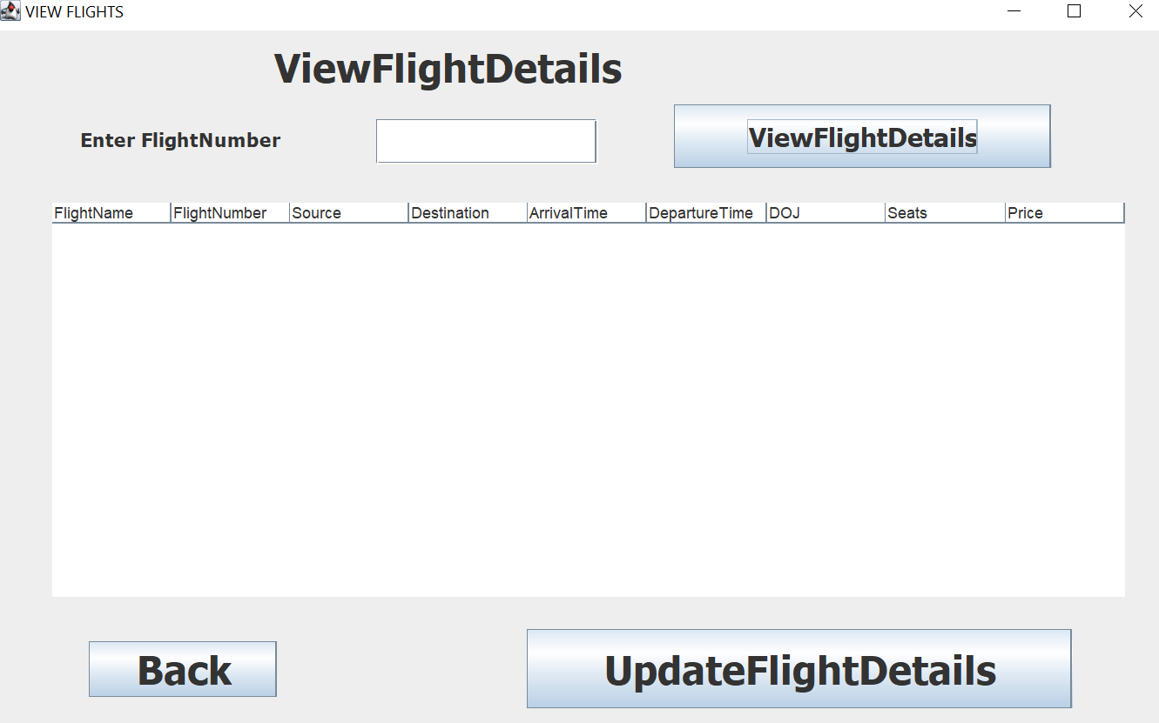
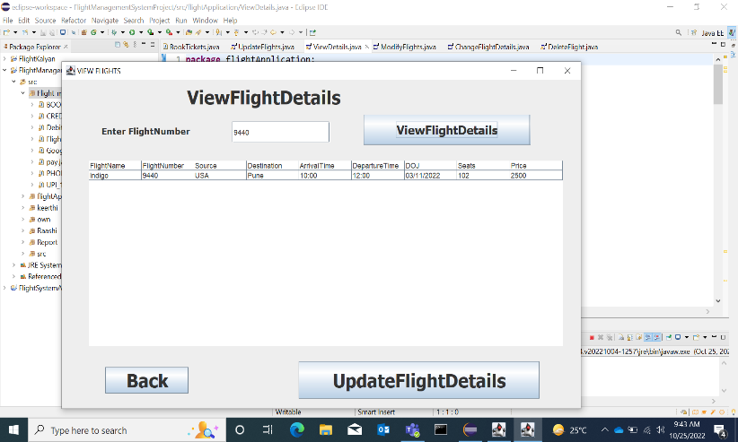
CONTINUATION…
VIEW FLIGHTS
This module will be enabled for admin only for updating the flight information purpose.
It will show flight information according to the inputs.
After getting the flight details the admin can update the new flight schedule like timings and removal of flight details.

Slide 9
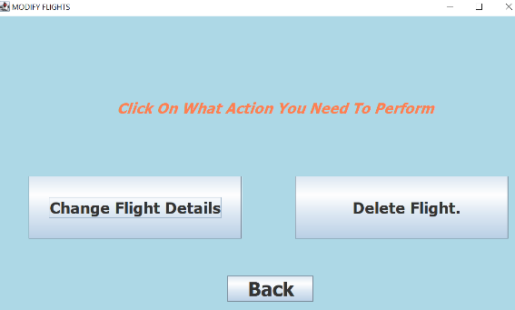
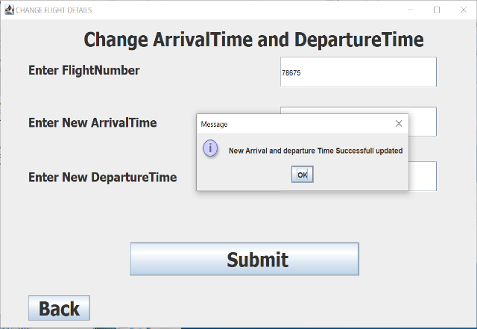
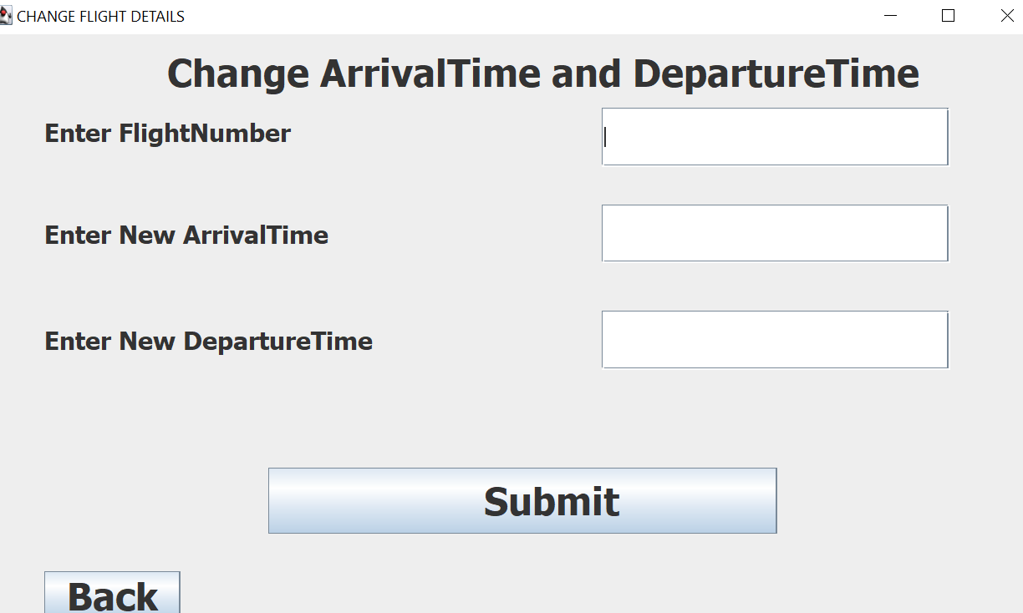
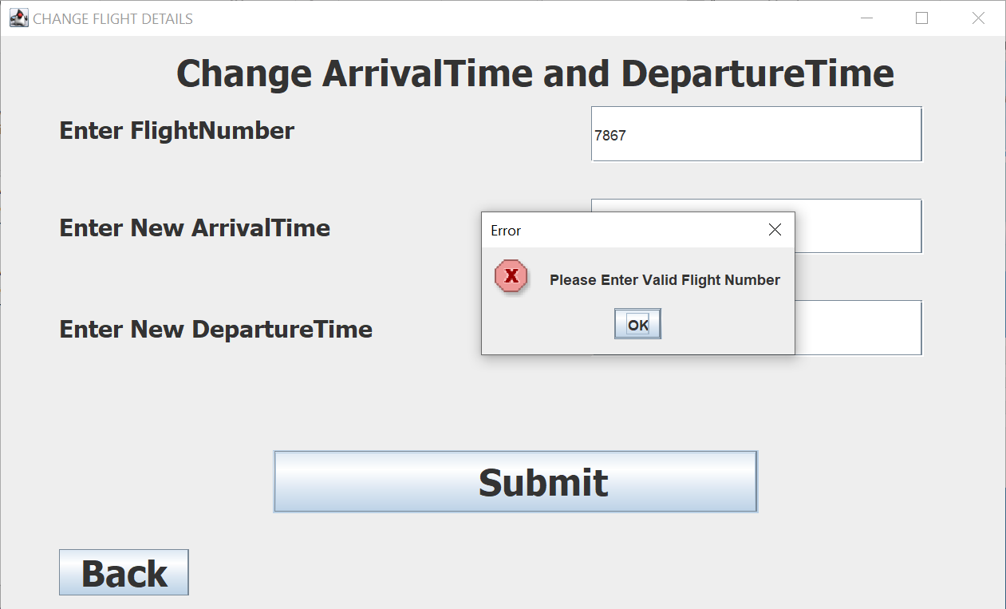
CONTINUATION…
UPDATE FLIGHTS
This module will be enabled for admin only for updating the flight information purpose.
It will show after selecting the update flight information.
From there we can update flight timings.
There will be an error message or success message according to the inputs.

Slide 10
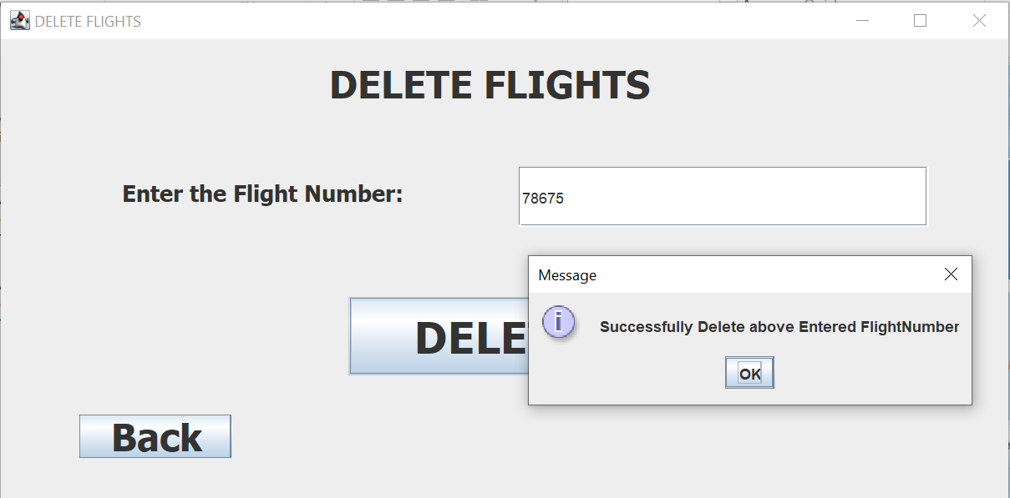
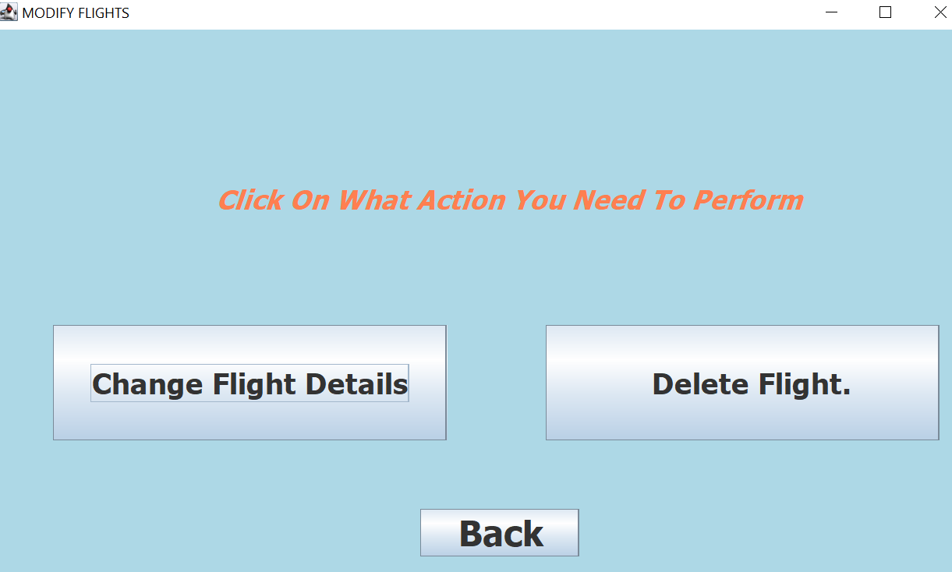
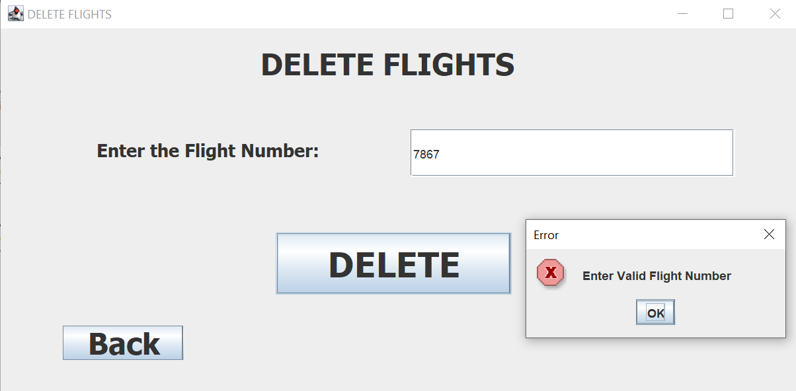
CONTINUATION…
Delete FLIGHTS
This module will be enabled for admin only for updating the flight information purpose.
It will show after selecting the update flight information.
From there we can update flight timings.
There will be an error message or success message according to the inputs.

Slide 11
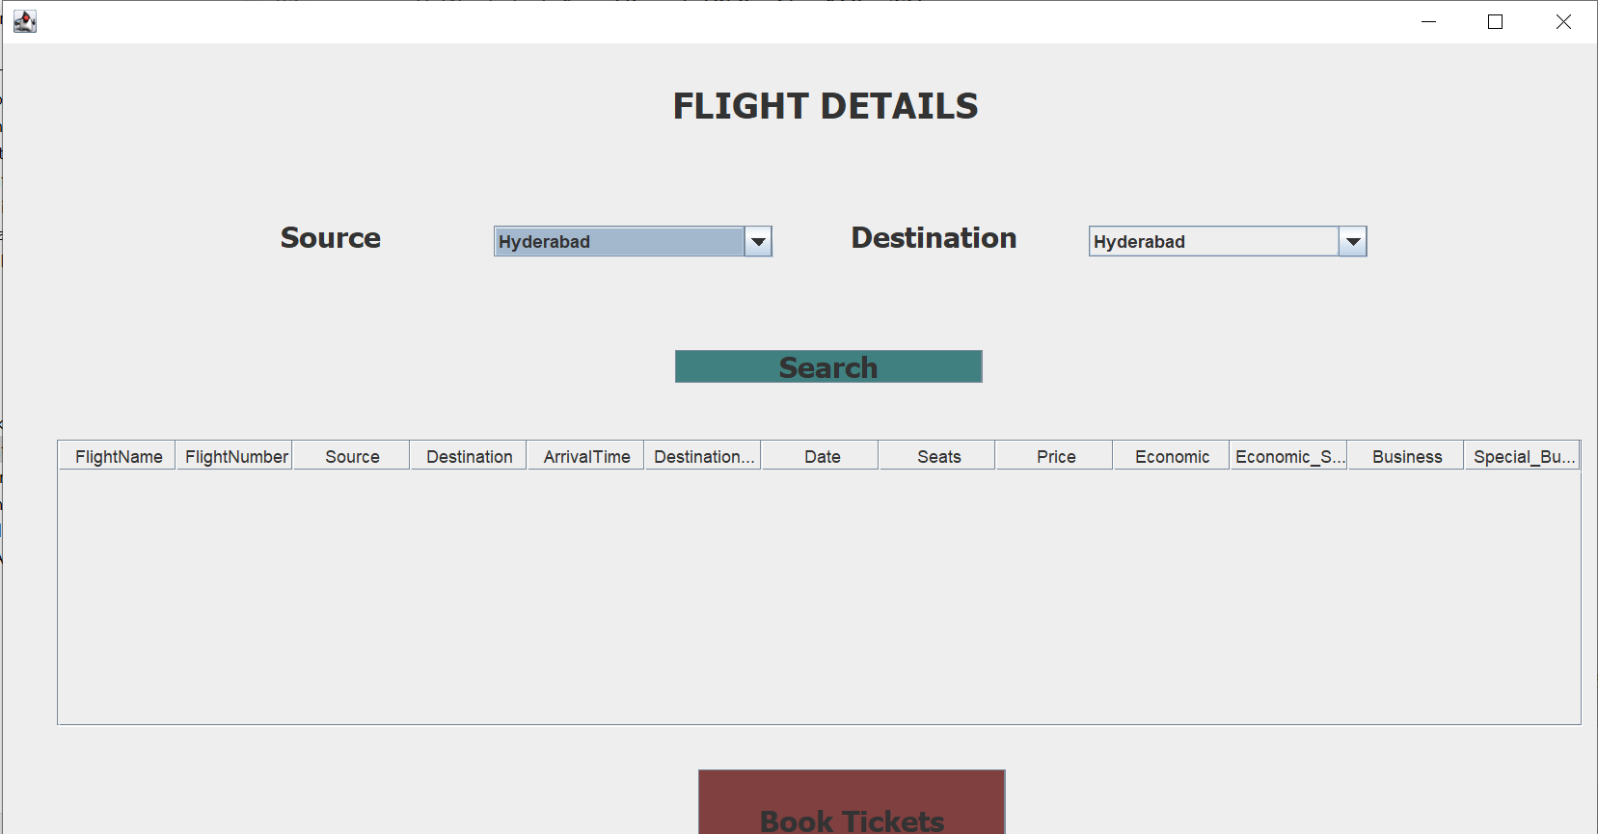
RESERVATION
This module help in booking a flight ticket.
For booking flight ticket user need to search the
flights based on source and destination.
Based on source and destination Flights will get
displayed in a table.

Slide 12
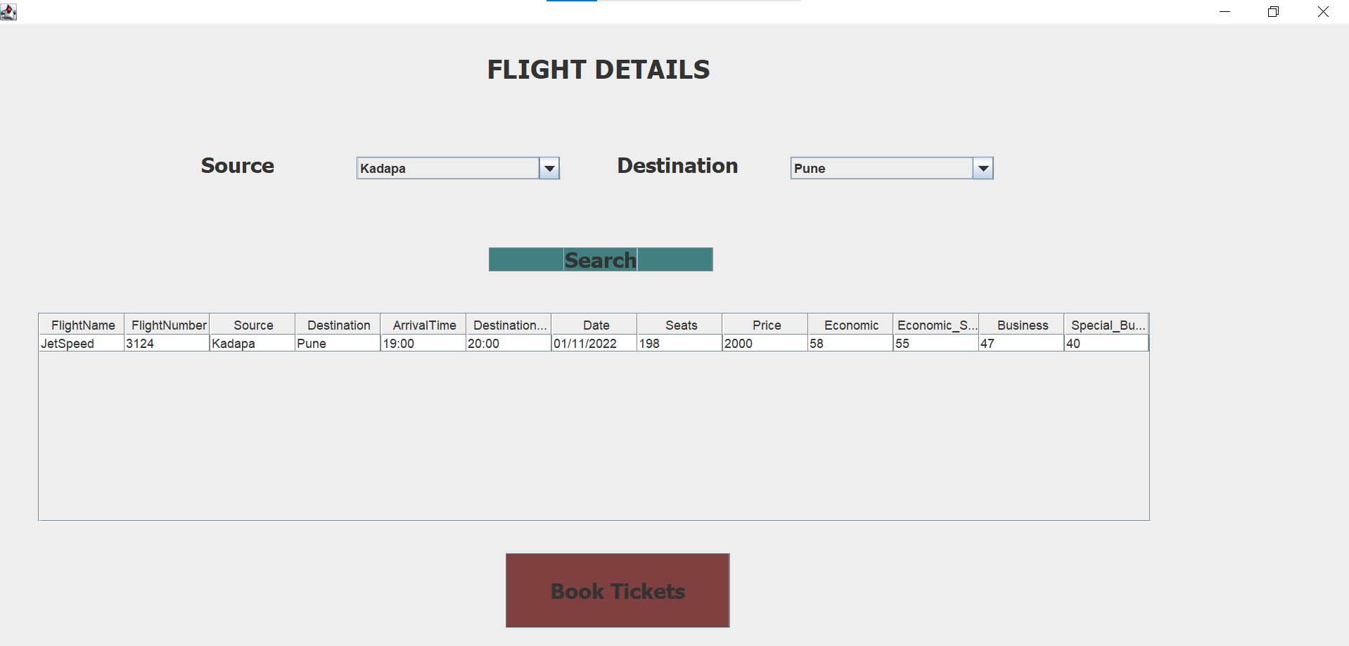
CONTINUATION…
Passenger select source and destination from the
combo box.
When the passenger clicks on search button then
flights will be displayed.
Then the next step is to book ticket , when
passenger clicks on book ticket a reservation form
will opens

Slide 13
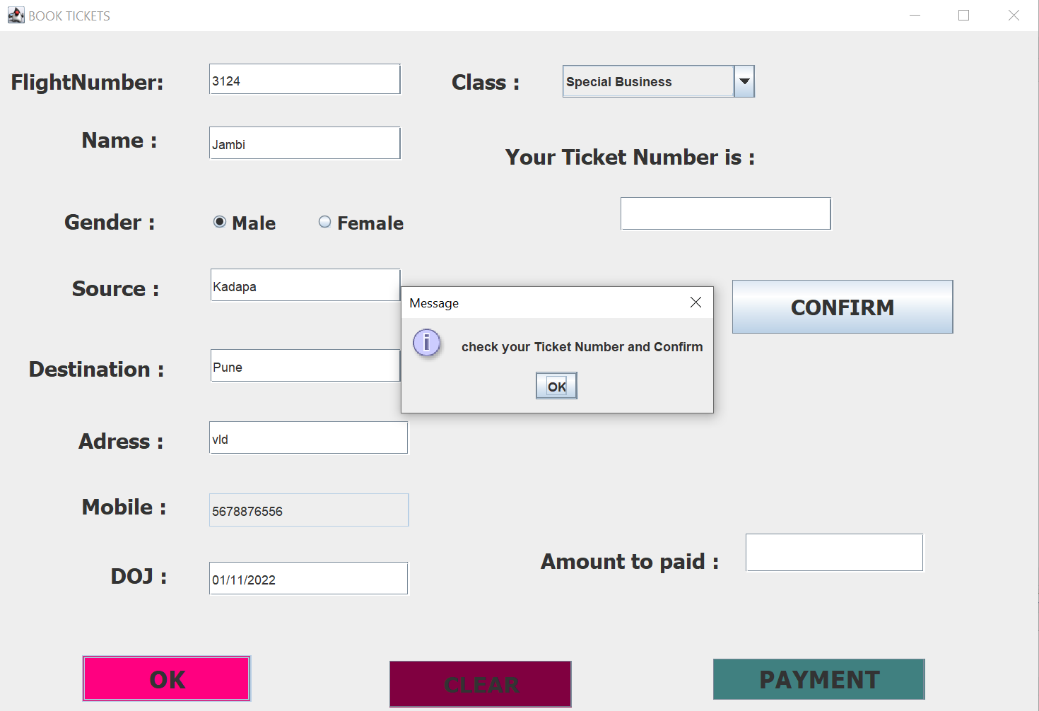
CONTINUATION…
Passengers need to fill the form based on his
journey.
Filling all the fields is mandatory.
Once he filled the form , when clicks on Ok
button then it shows dialog box as
“check your ticket number confirm” and
all fields values stores in the database.

Slide 14

CONTINUATION…
After entering ok in the dialog box then ticket number will generated .
When the passenger enters on confirm button Ticket gets confirmed in the backend number seats in that flight will get reduced as well.
After this passenger wants to go to payment method.

Slide 15
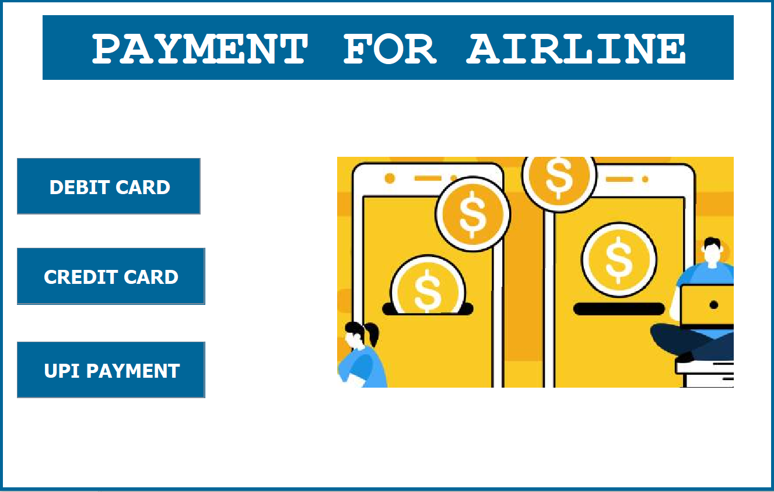
PAYMENT mODULE
This module helps in booking a flight ticket .
It gives us options of different methods to pay.
We can pay through :-
DEBIT CARD
CREDIT CARD
UPI PAYMENT

Slide 16
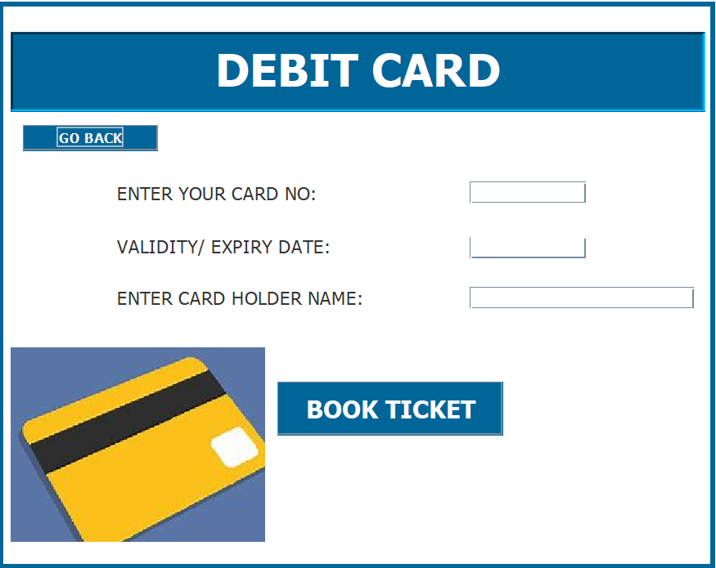
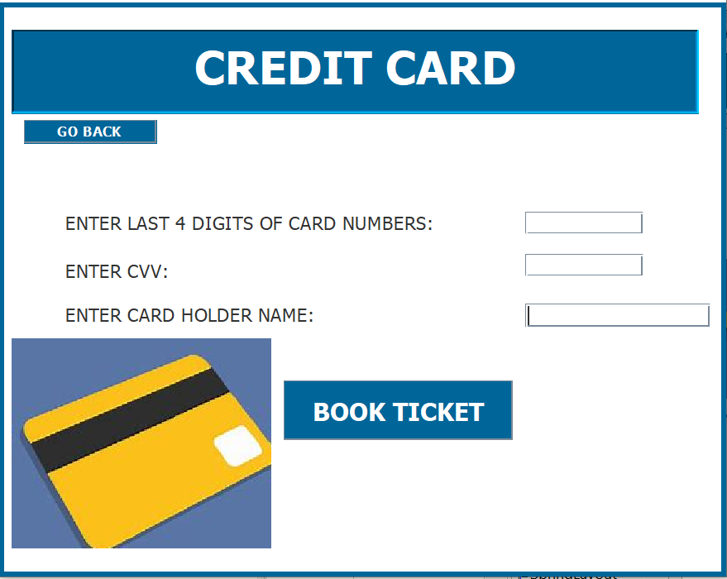
CARD PAYMENTS
Here, person has to enter their card details such as card number, validity and expiry date, cvv number and card holder name.
Every field has a validation and all the fields are mandatory to enter.
The entered values are stored in the database. . Incase of cancellation of a ticket the amount will be reimbursed into the persons account.

Slide 17
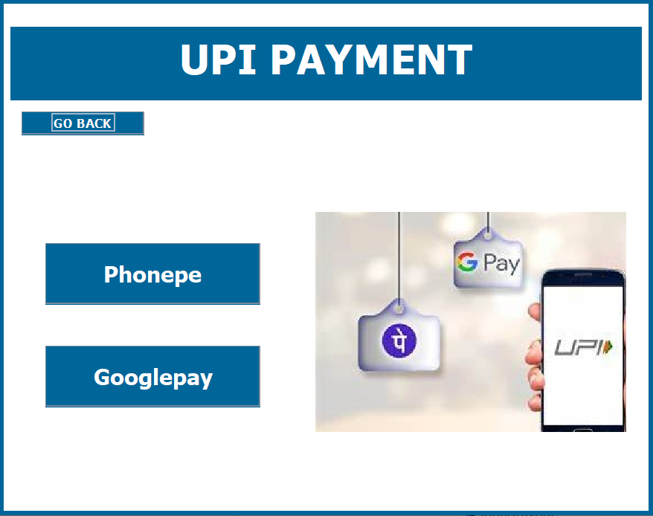
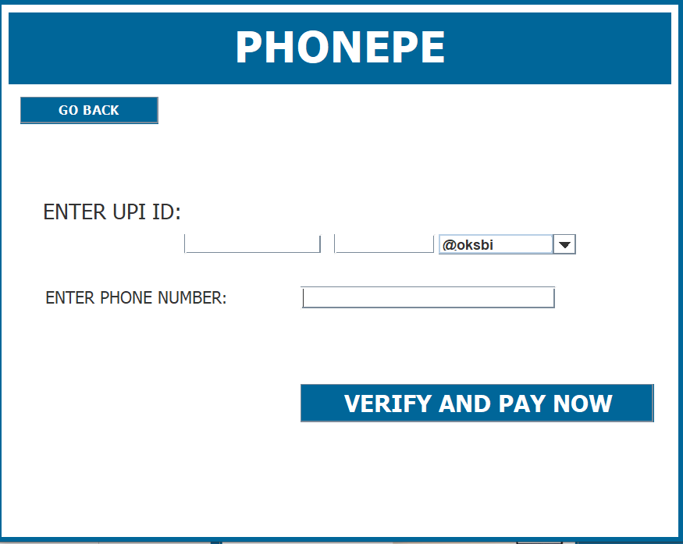
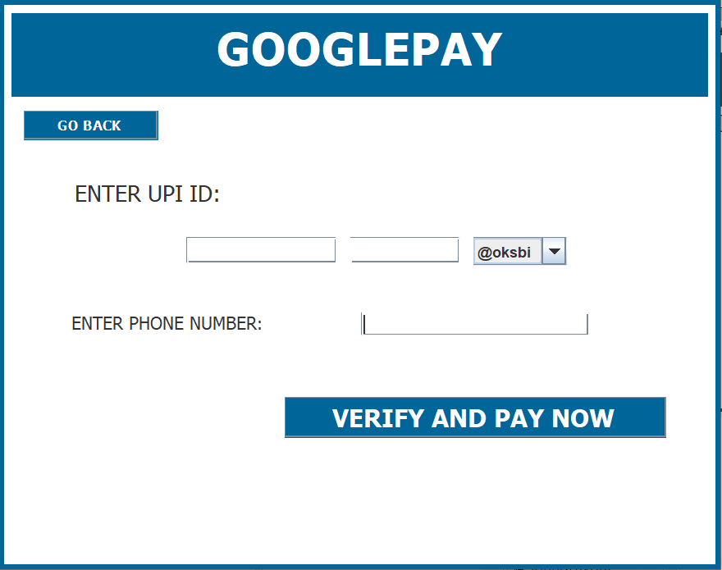
Upi payment
UPI payment consists of 2 option they are :-
Phonepe
Googlepay
Here, person is asked to enter their UPI ID along with their phone number, the entered fields are saved into the database. Incase of cancellation of a ticket the amount will be reimbursed into the persons account.

Slide 18
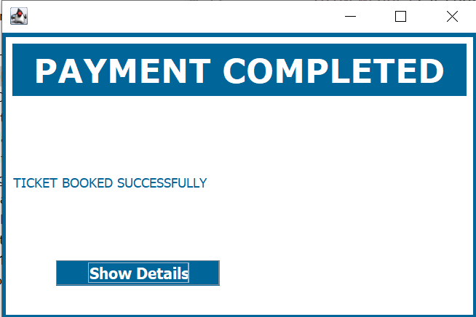
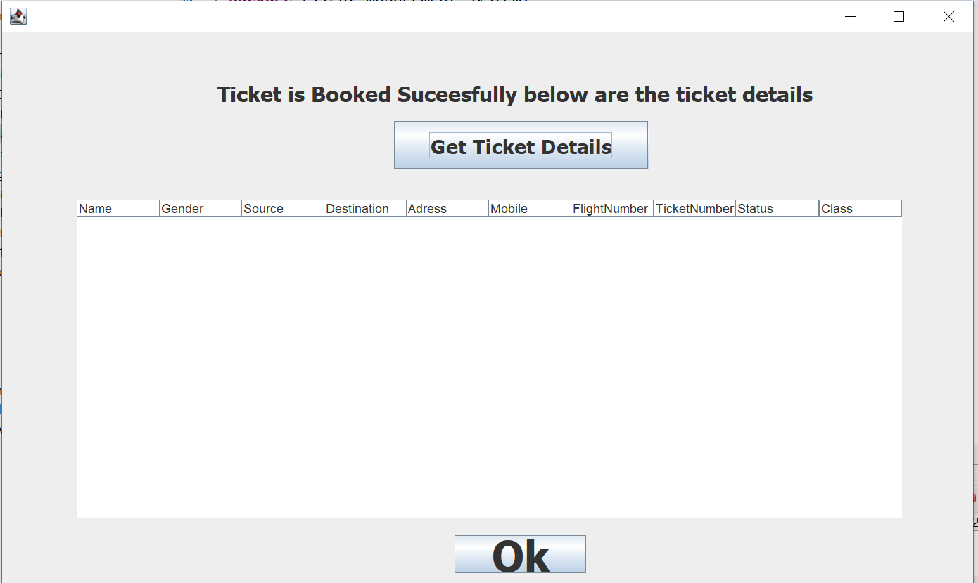
Payment completed
Once the person clicks the button “BOOK NOW” the payment is successfully completed and following window is shown.
The person now can exit the payment window.

Slide 19
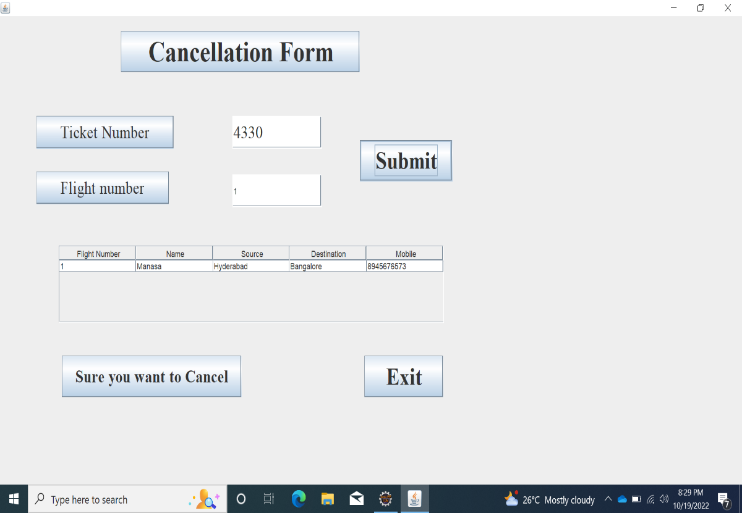
CANCELLATION
This Module will helps in Cancelling the Airline Tickets.
Here, person is used to enter the Ticket Number and Flight Number.
After submitting we can see user details.

Slide 20
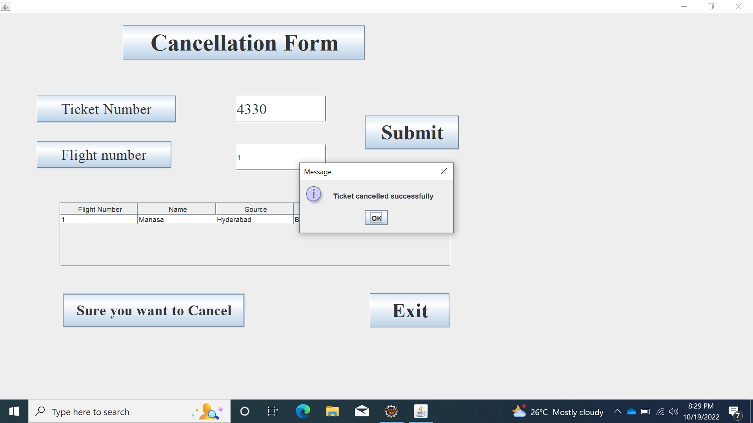
CONTINUATION…
After Pressing Sure you want to cancel, then the Ticket will be cancelled successfully.

Slide 21

CONTINUATION…
If we enter wrong Ticket Number or Flight Number it will pop a message.

Slide 22
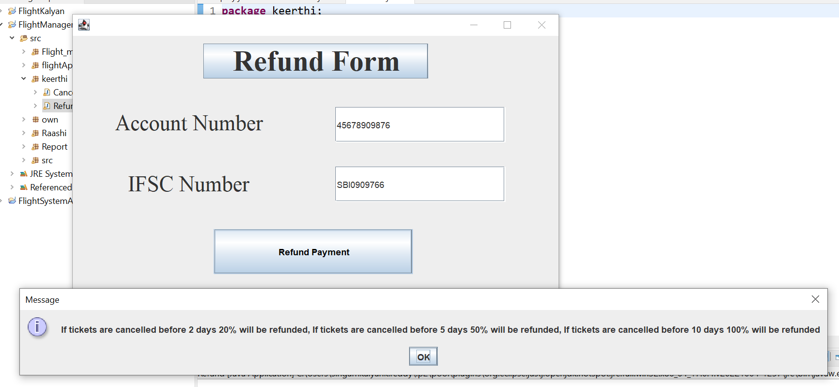
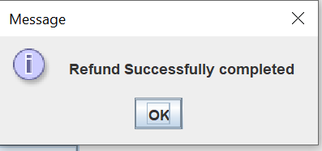
CONTINUATION…
After pressing Refund payment button It will pop a message regarding amount refunded.

Slide 23
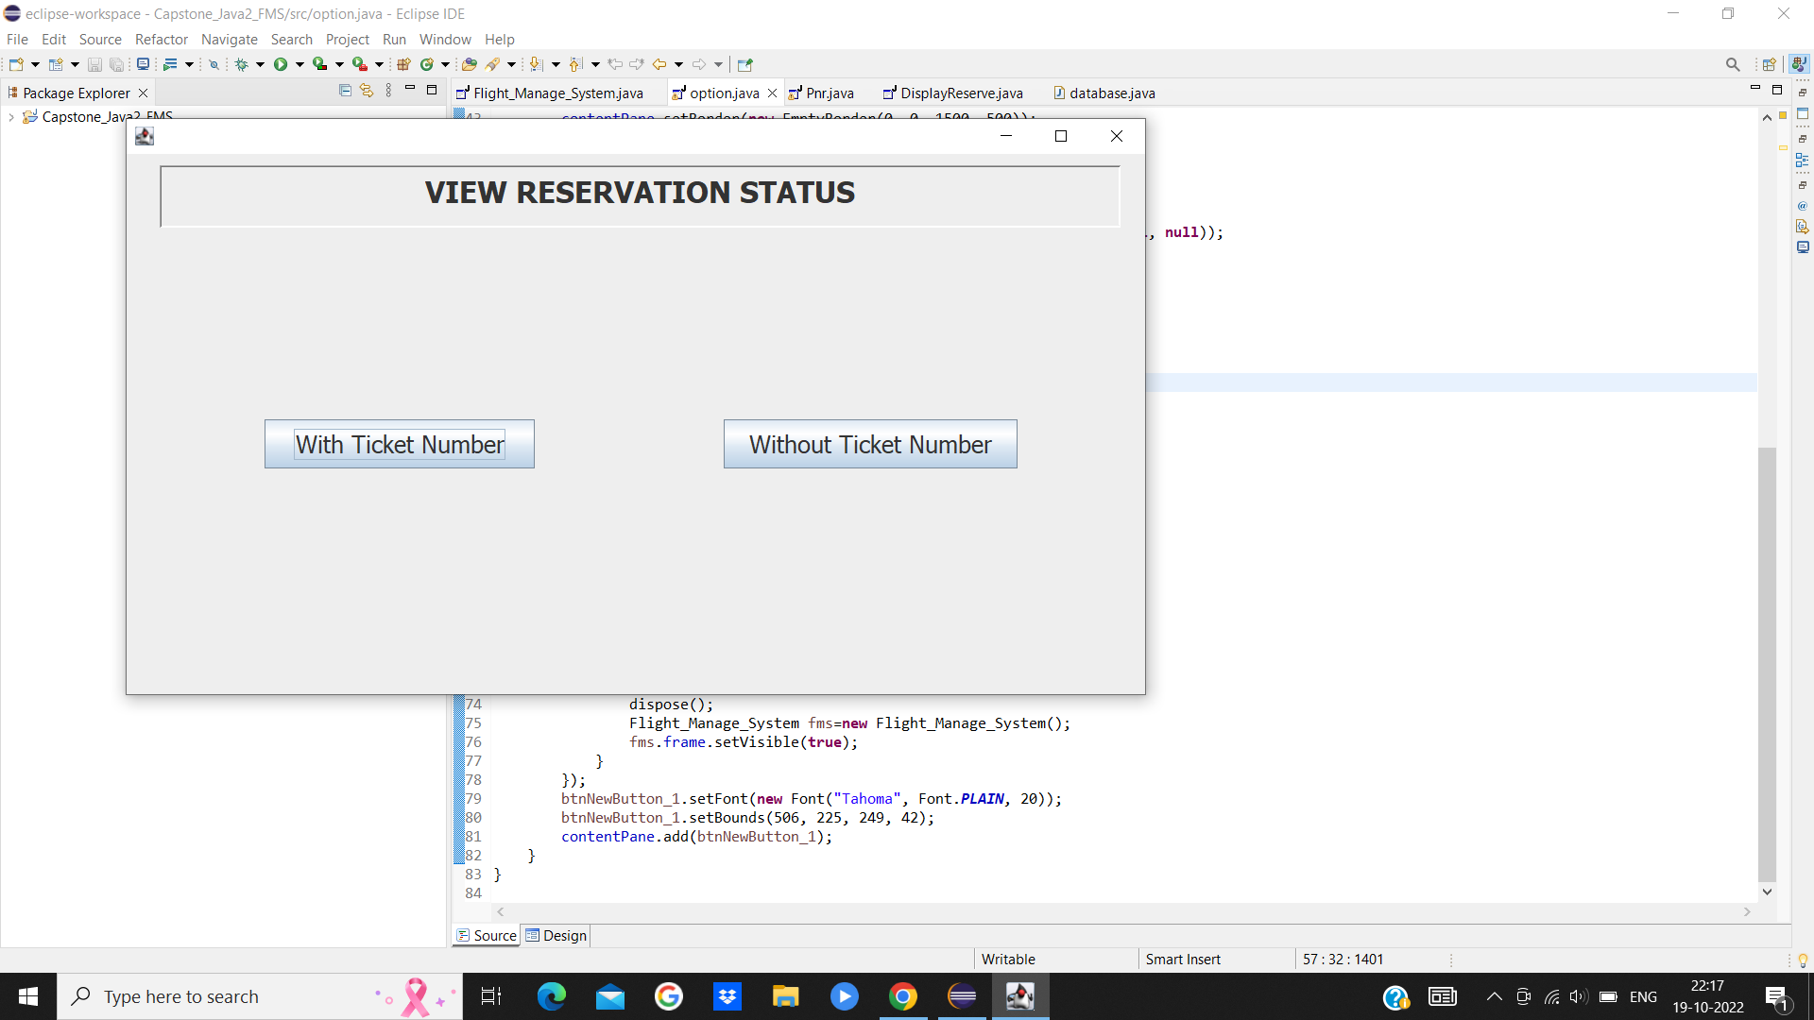
VIEW RESERVATION STATUS
It is necessary to know your journey gateway’s status i.e. the reservation status. For viewing the Reservation status, there are 2 ways :
~ With Ticket number, usually known as PNR number.
~ Without Ticket number, with the help of sufficient data like:
* Registered Phone number
* Date of your Journey
* Source
* Destination

Slide 24
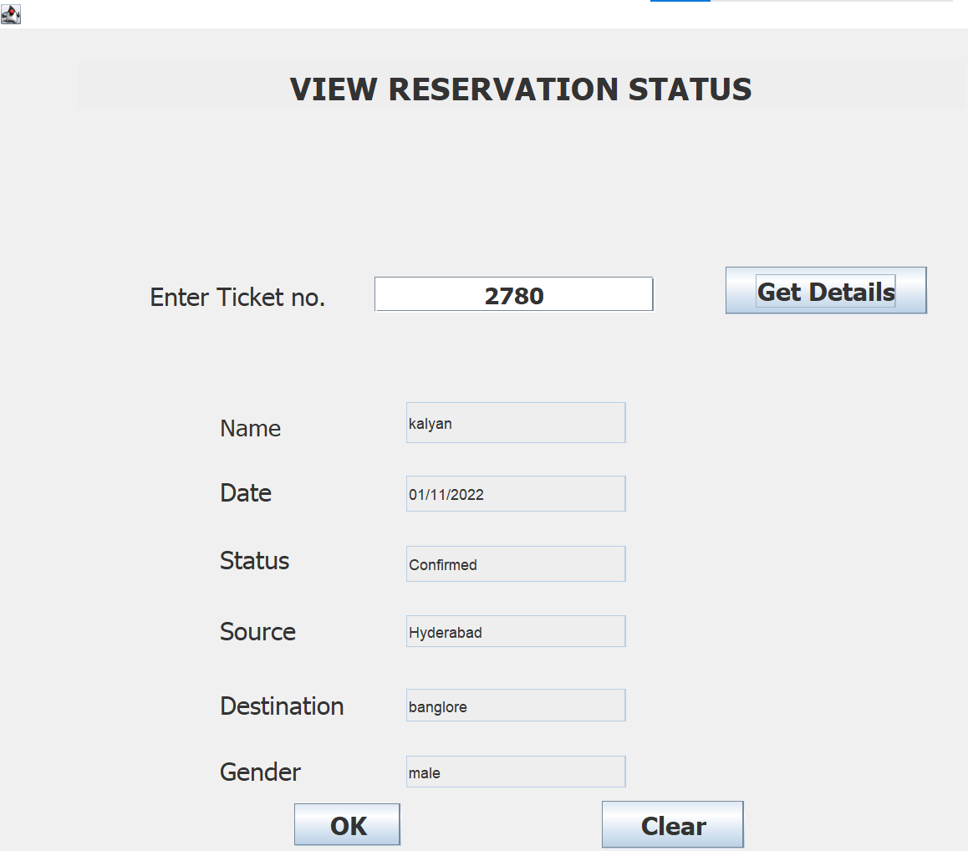
WITH TICKET NUMBER…
The code printed on each ticket says it all about the passenger’s details.
With necessary validation, with the help of ticket number alone you can get the necessary details.
Validation includes a valid ticket number otherwise a pop-up will appear telling about the invalidity and will remain the same unless and until the Number provided is valid.

Slide 25
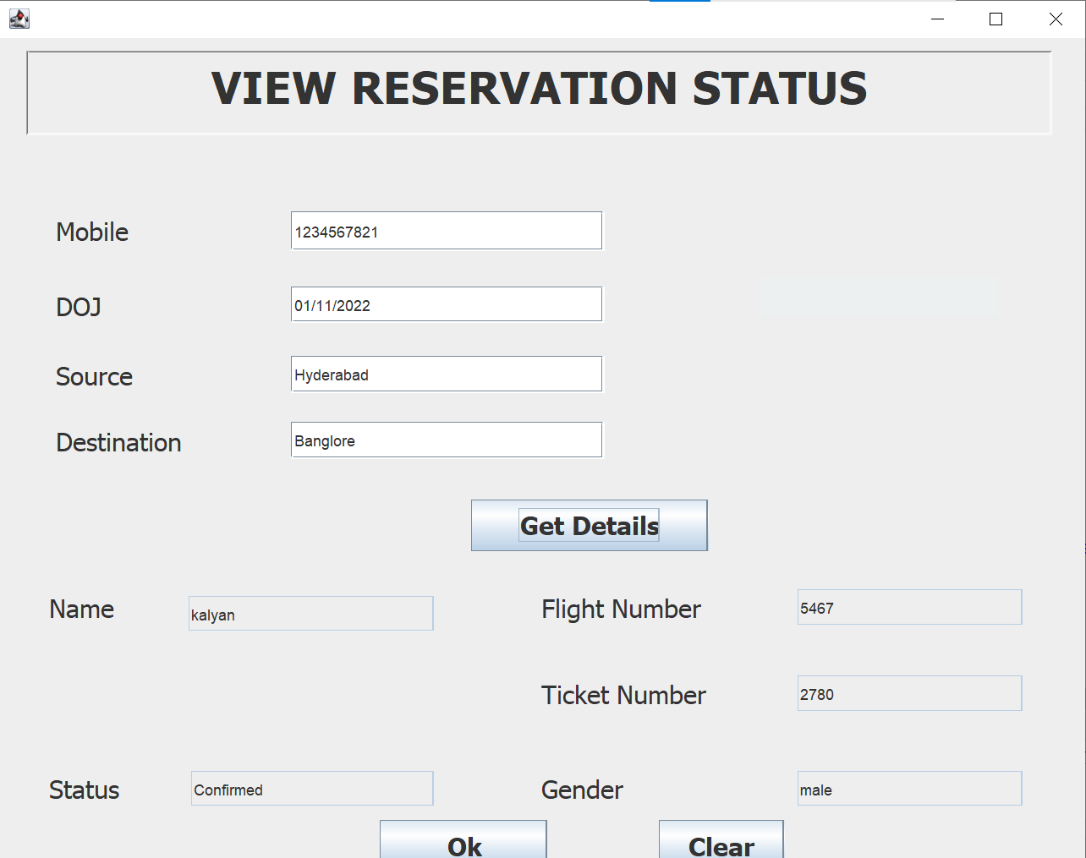
WITHOUT TICKET NUMBER…
By chance if the code printed on each ticket is not available, you can get passenger details without it.
With the necessary validations, you can get the necessary details.
Validation includes a valid mobile number otherwise a pop-up will appear telling about the invalidity and will remain the same unless and until the phone number provided is valid.
Date must be in dd/mm/yyyy format only.

Slide 26
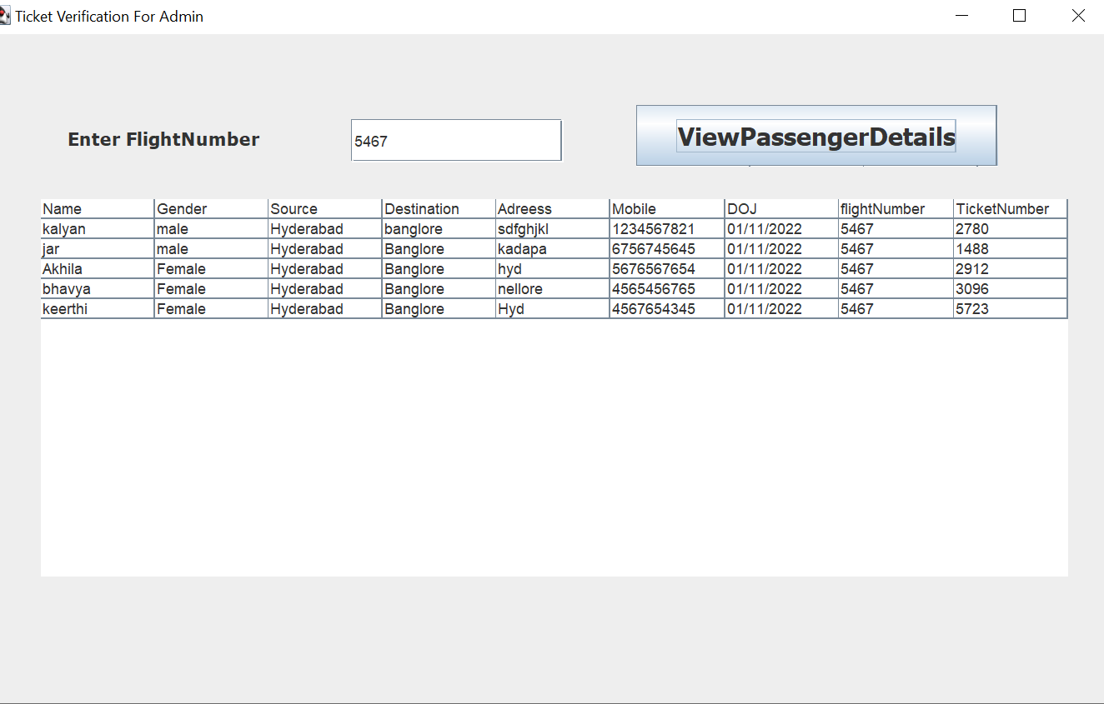
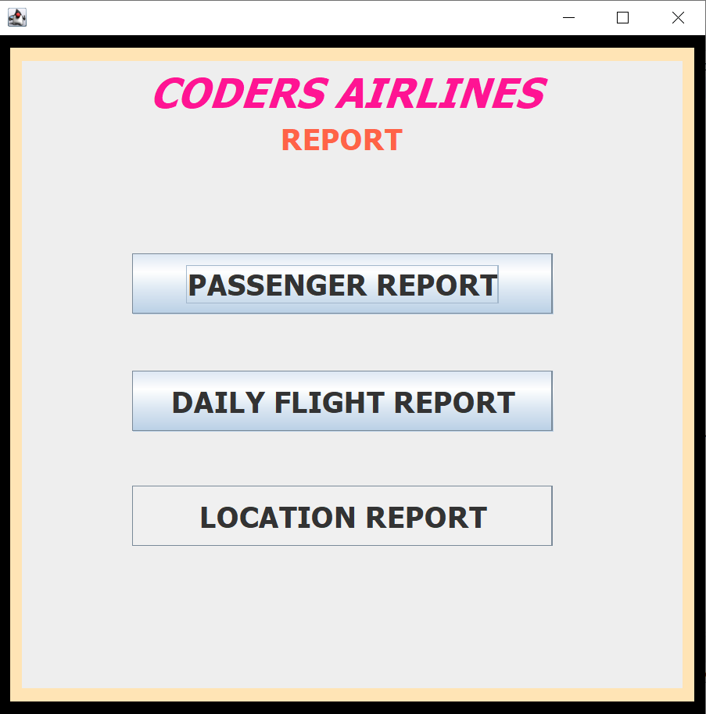
REPORT
If admin wants a report of the flight details, like passenger details report ,daily flights report and location to location report, admin can select the required report button and then he/she need to enter the required information to get the details as pdf file.

Slide 27
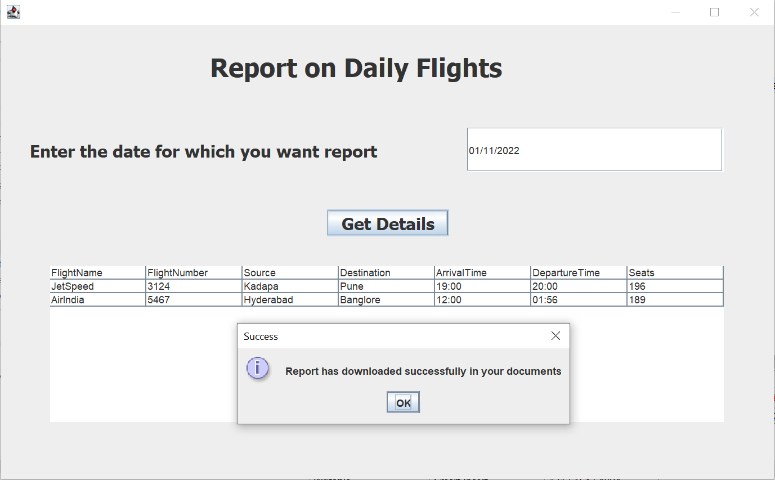
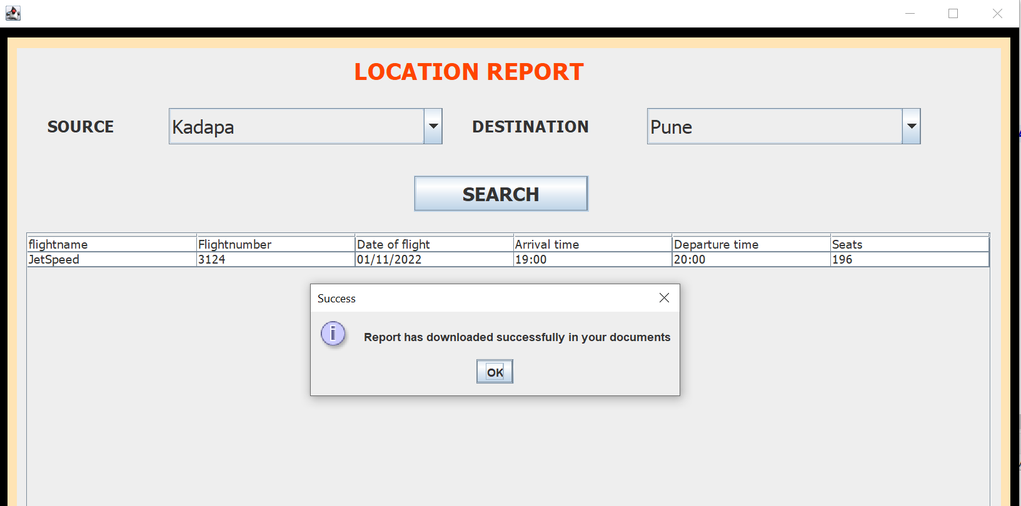
CONTINUATION…

Slide 28
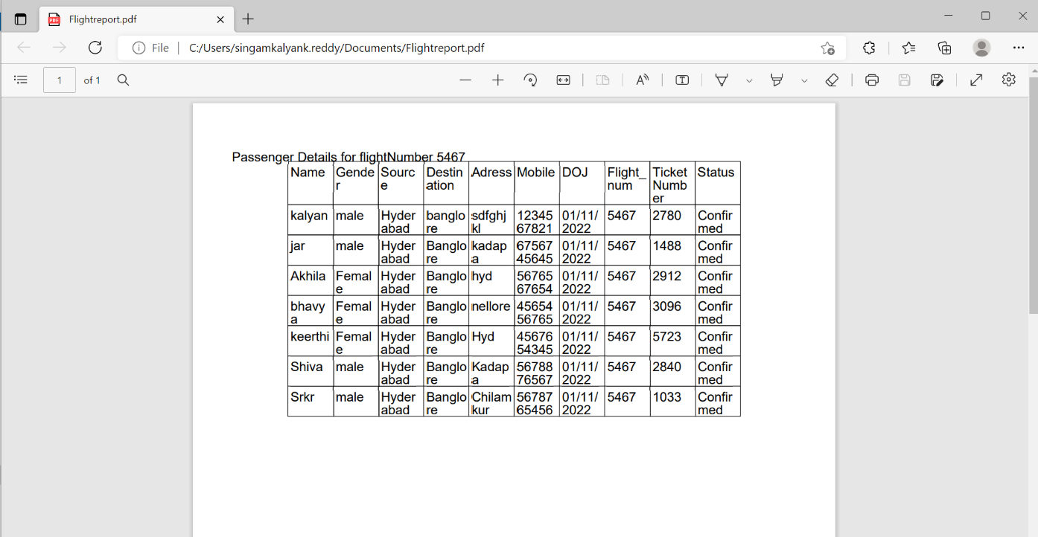
REPORT IN PDF FORMAT
When the admin needs the passenger details as a report, we the programmers provide a code for the download of the report in pdf format.
This will help the admin to check the passenger details in a hard copy.

Slide 29
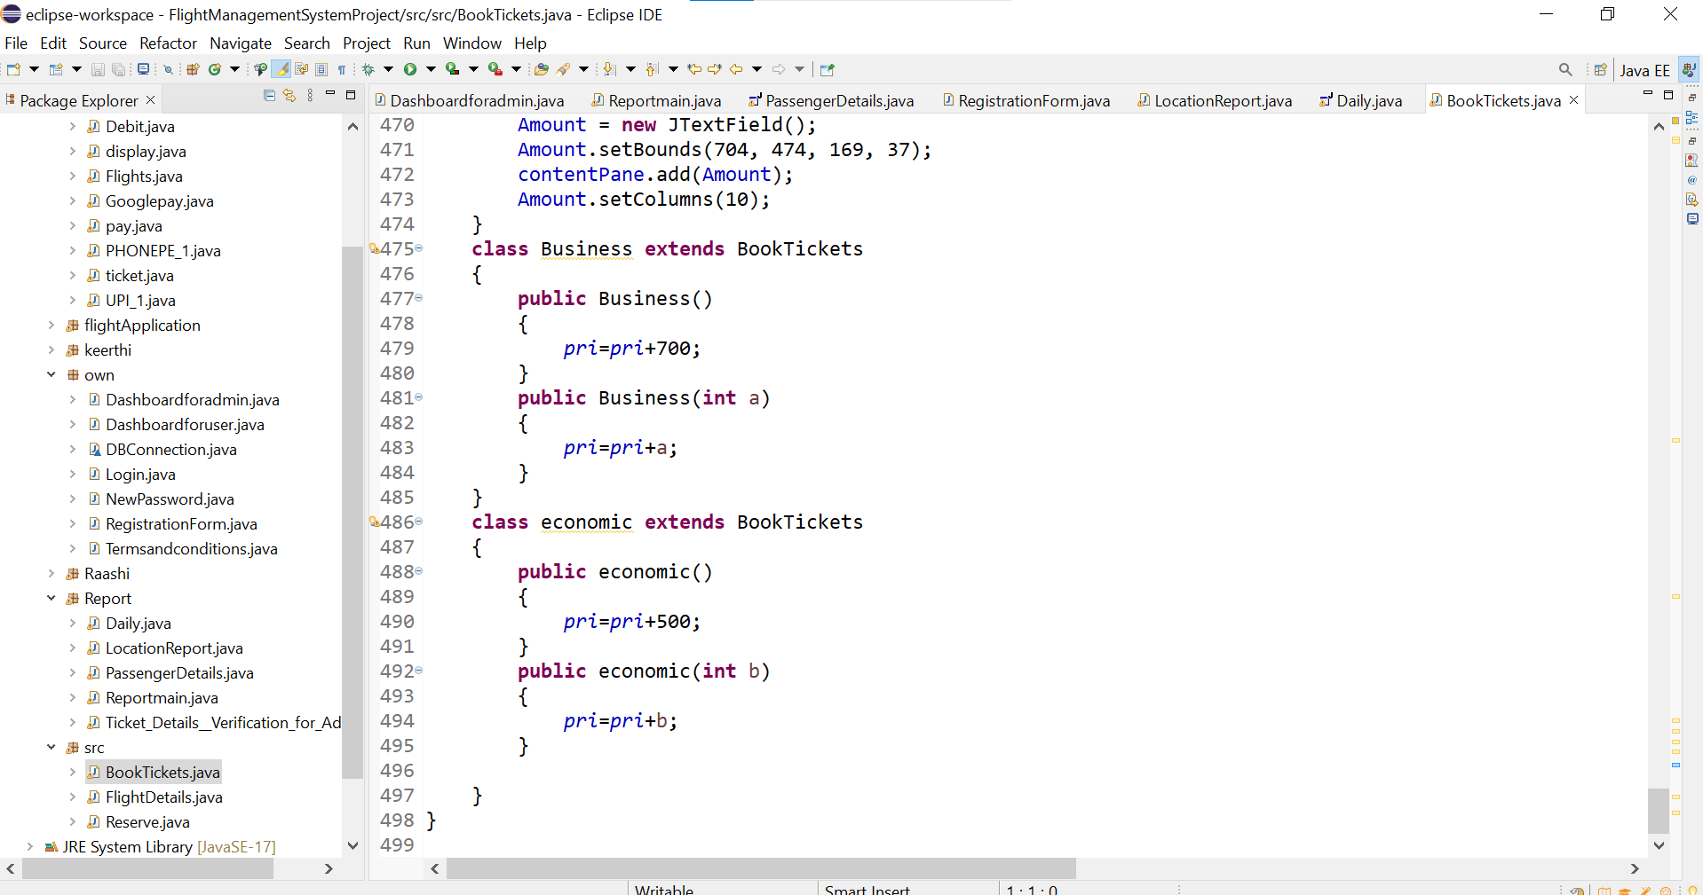
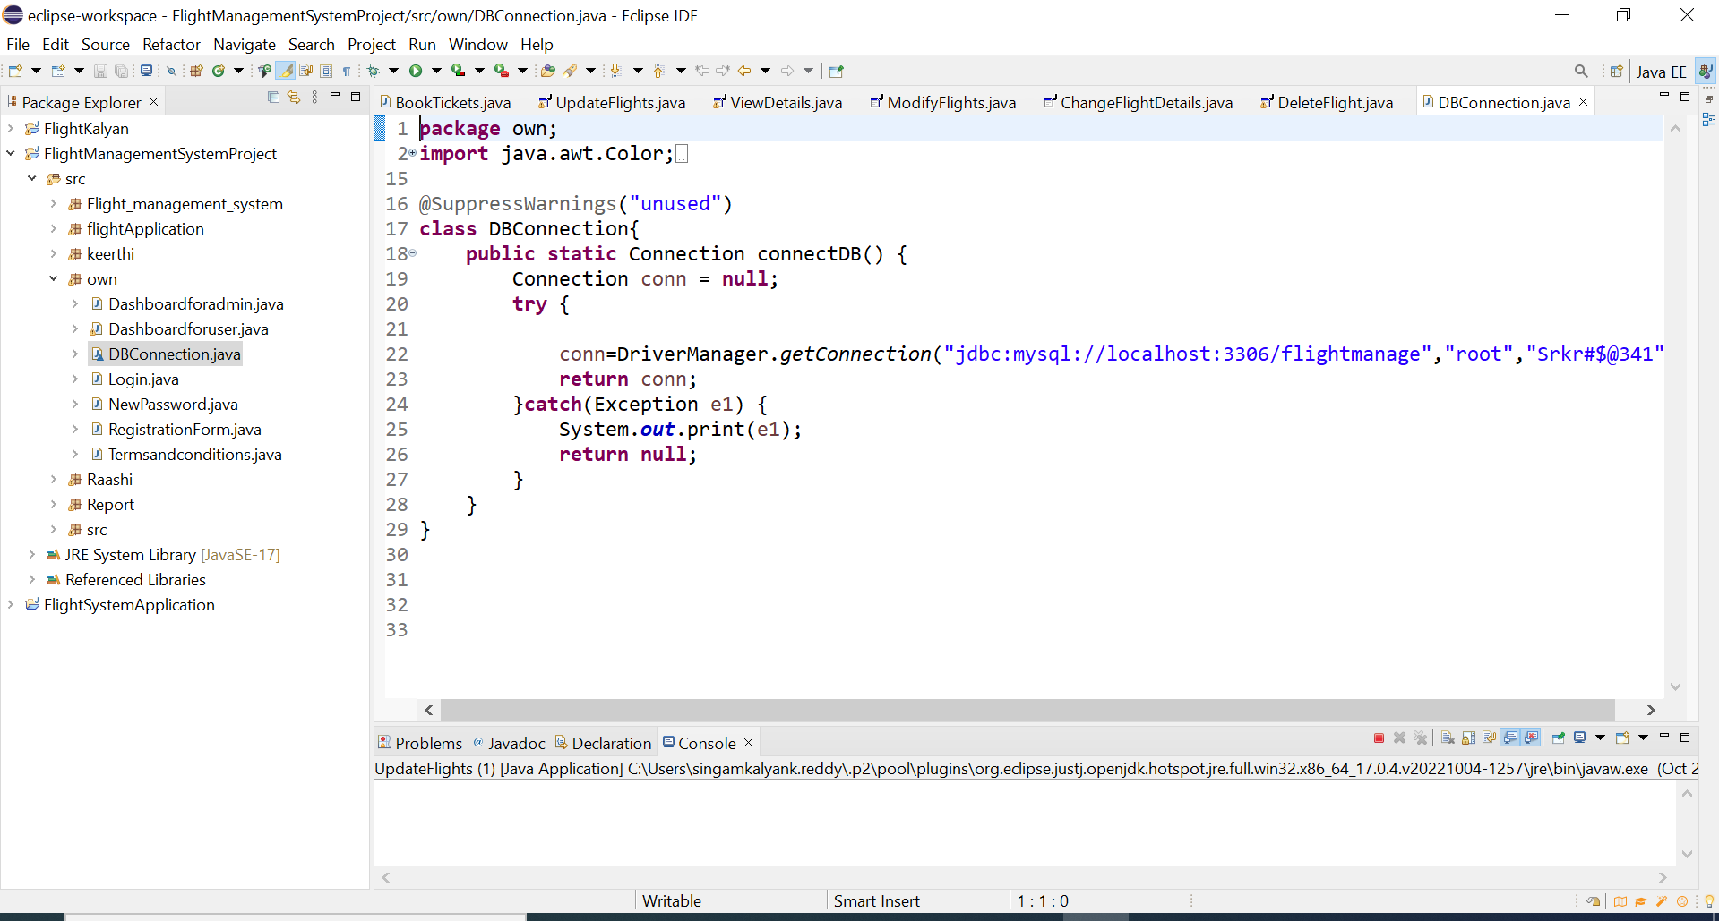
OOPS CONCEPTS
In our project we used the oops concepts mainly inheritance, polymorphism and exception handling.
Inheritance is done by extending the code from the class BookTickets.
The polymorphism and exception handling is done by connecting the frontend and backend.
The connection can be used in the whole project with many forms.

Slide 30
ANY QUERIES…?

Slide 31
THANK YOU…!

